Slide 1

CHAPTER 4
ELEMENTARY NUMBER THEORY AND METHODS OF PROOF
Copyright © Cengage Learning. All rights reserved.

Slide 2

4.7
Indirect Argument: Contradiction and Contraposition
Copyright © Cengage Learning. All rights reserved.

Slide 3
Indirect Argument: Contradiction and Contraposition
Indirect proofs are more roundabout. One kind of indirect proof, argument by contradiction, is based on the fact that either a statement is true or it is false but not both.
So if you can show that the assumption that a given statement is not true leads logically to a contradiction, impossibility, or absurdity, then that assumption must be false: and, hence, the given statement must be true.
This method of proof is also known as reductio ad impossible or reductio ad absurdum because it relies on reducing a given assumption to an impossibility or absurdity.

Slide 4
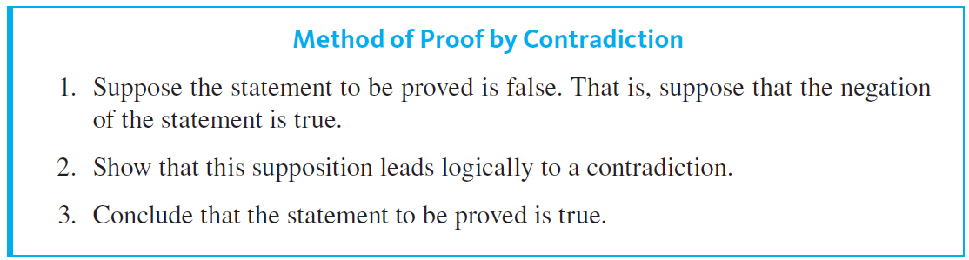
Indirect Argument: Contradiction and Contraposition

Slide 5
Example 4.7.1 – There Is No Greatest Integer
Use proof by contradiction to show that there is no greatest integer.

Slide 6
Example 4.7.1 – Solution
For this proof, the “certain property” is the property of being the greatest integer.
So prove that there is no object with this property, begin by supposing the negation: that there is an object with the property.
Starting Point: Suppose not. Suppose there is a greatest integer; call it N. This means that N ≥ n for every integer n.

Slide 7
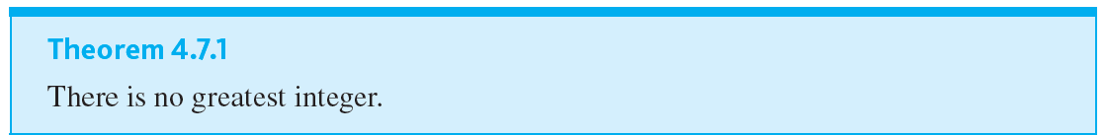
Example 4.7.1 – Solution
continued
To Show: This supposition leads logically to a contradiction.

Slide 8
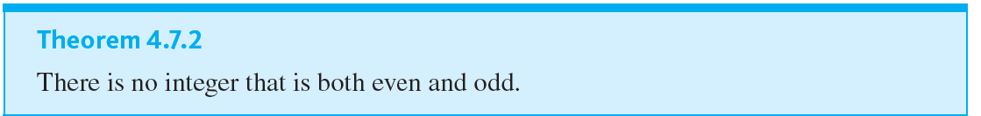
Example 4.7.2 – No Integer Can Be Both Even and Odd
The fact that no integer is both even and odd can also be deduced from the uniqueness part of the quotient-remainder theorem.

Slide 9
Example 4.7.3 – The Sum of a Rational Number and an Irrational Number
Use proof by contradiction to show that the sum of any rational number and any irrational number is irrational.

Slide 10
Example 4.7.3 – Solution
Begin by supposing the negation of what you are to prove. Be very careful when writing down what this means.
If you take the negation incorrectly, the entire rest of the proof will be flawed.
In this example, the statement to be proved can be written formally as
∀ real numbers r and s, if r is rational and
s is irrational, then r + s is irrational.

Slide 11
Example 4.7.3 – Solution
continued
From this you can see that the negation is
∃ a rational number r and an irrational number
s such that r + s is rational.
It follows that the starting point and what is to be shown are as follows:
Starting Point: Suppose not. That is, suppose there is a rational number r and an irrational number s such that r + s is rational.

Slide 12
Example 4.7.3 – Solution
continued
To Show: This supposition leads to a contradiction.
To derive a contradiction, you need to understand what you are supposing: that there are numbers r and s such that r is rational, s is irrational, and r + s is rational. By definition of rational and irrational, this means there are convenient expressions that can be substituted for r and r + s, but all you can say about s is that it cannot be written as a quotient of integers

Slide 13




Example 4.7.3 – Solution
continued
If you substitute (4.7.1) into (4.7.2), you obtain
Subtracting a ∕ b from both sides gives

Slide 14
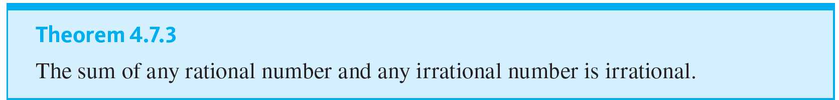
Example 4.7.3 – Solution
continued
Now both bc − ad and bd are integers because products and differences of integers are integers, and bd ≠ 0 by the zero product property.
Hence s can be expressed as a quotient of two integers with a nonzero denominator, and so s is rational, which contradicts the supposition that it is irrational.

Slide 15
Argument by Contraposition

Slide 16
Argument by Contraposition
A second form of indirect argument, argument by contraposition, is based on the logical equivalence between a statement and its contrapositive.
To prove a statement by contraposition, you take the contrapositive of the statement, prove the contrapositive by a direct proof, and conclude that the original statement is true.

Slide 17
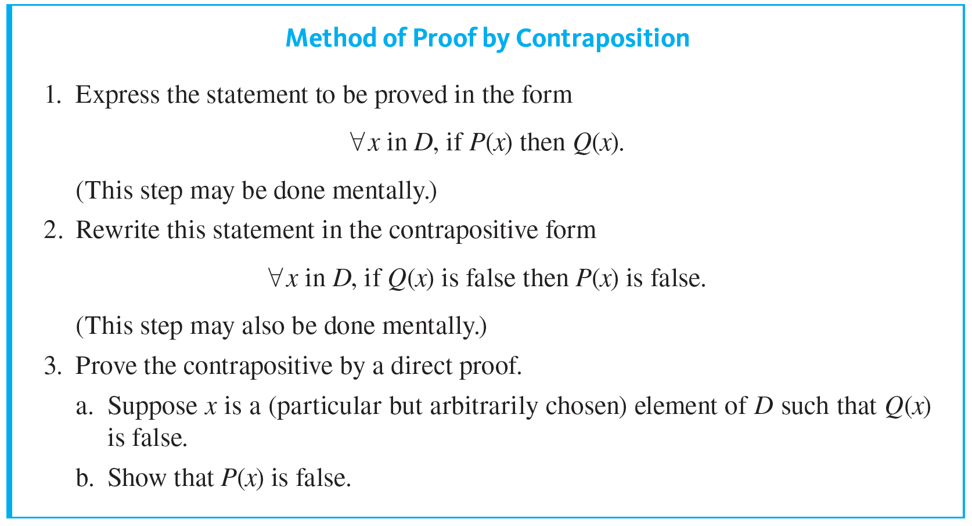
Argument by Contraposition

Slide 18

Example 4.7.4 – If the Square of an Integer Is Even, Then the Integer Is Even
Prove that for every integer n, if
is even then n is even.

Slide 19
Example 4.7.4 – Solution
First form the contrapositive of the statement to be proved.
Contrapositive: For every integer n, if n is not even then
is not even.
By the quotient-remainder theorem with divisor equal to 2, any integer is even or odd, and, by Theorem 4.7.2, no integer is both even and odd.

Slide 20

Example 4.7.4 – Solution
continued
So if an integer is not even, then it is odd. Thus the contrapositive can be restated as follows:
Contrapositive: For every integer n, if n is odd then
is odd.

Slide 21
Relation between Proof by Contradiction and Proof by Contraposition

Slide 22


Relation between Proof by Contradiction and Proof by Contraposition
Observe that any proof by contraposition can be recast in the language of proof by contradiction. In a proof by contraposition, the statement
∀x in D, if P(x) then Q(x)
is proved by giving a direct proof of the equivalent statement
To do this, you suppose you are given an arbitrary element x of D such that

Slide 23

Relation between Proof by Contradiction and Proof by Contraposition
You then show that
This is illustrated in Figure 4.7.1.
Proof by Contraposition
Figure 4.7.1
To rewrite the proof as a proof by contradiction, you suppose there is an x in D such that P(x) and
You then follow the steps of the proof by contraposition to deduce the statement

Slide 24

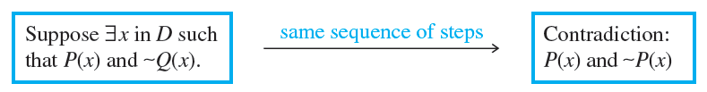
Relation between Proof by Contradiction and Proof by Contraposition
But
is a contradiction to the supposition that P(x) and
(Because to contradict a conjunction of two statements, it is only necessary to contradict one of them.) This process is illustrated in Figure 4.7.2.
Proof by Contradiction
Figure 4.7.2

Slide 25
Proof as a Problem-Solving Tool

Slide 26
Proof as a Problem-Solving Tool
Direct proof, disproof by counterexample, proof by contradiction, and proof by contraposition are all tools that may be used to help determine whether statements are true or false.
Working with examples might have given you a sense that a statement of the form
For all elements in a domain, if (hypothesis) then (conclusion),
might be true. To explore further, imagine elements in the domain that satisfy the hypothesis.

Slide 27
Proof as a Problem-Solving Tool
Ask yourself: Must they satisfy the conclusion? If you can see that the answer is “yes” in all cases, then the statement is true and your insight will form the basis for a direct proof.
If after some thought it is not clear that the answer is “yes,” ask yourself whether there are elements of the domain that satisfy the hypothesis and not the conclusion. If you are successful in finding some, then the statement is false and you have a counterexample.
On the other hand, if you are not successful in finding such elements, perhaps none exist.

Slide 28
Proof as a Problem-Solving Tool
Perhaps you can show that assuming the existence of elements in the domain that satisfy the hypothesis and not the conclusion leads logically to a contradiction. If so, then the given statement is true and you have the basis for a proof by contradiction.
Alternatively, you could imagine elements of the domain for which the conclusion is false and ask whether such elements also fail to satisfy the hypothesis. If the answer in all cases is “yes,” then you have a basis for a proof by contraposition.

